Slide 1
Project 2:Proposal

Slide 2
Group 4 Team Members
Scott Whigham
Henry Greyner
Austin Potts
Lansing Westlake
Nyarai Nhamoinesu

Slide 3
Day 1
Topic :
Impact of COVID19 on crime trends. (NY, San Francisco, Seattle, Dallas)
Datasets:
Dallas Open data portal: https://www.dallasopendata.com/
San Fran open data portal: https://datasf.org/opendata/
Texas open data portal: https://data.texas.gov/
Seattle open data portal: https://data.seattle.gov/
Finding Inspiration:
Google trends
“Sketching” your ideal visuals

Slide 4

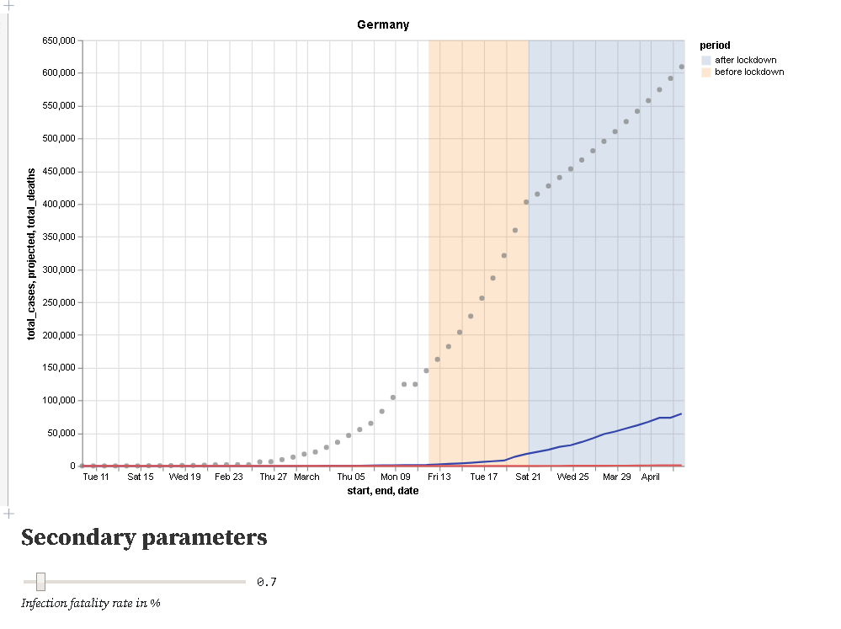
Interactive Graphs
Drag and drop or dropdown

Slide 5
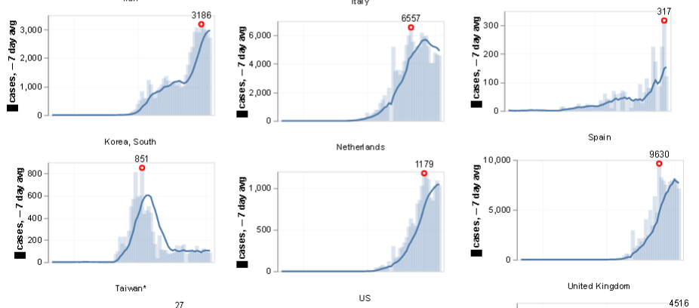
Plotting City Data for Multiple Cities

Slide 6
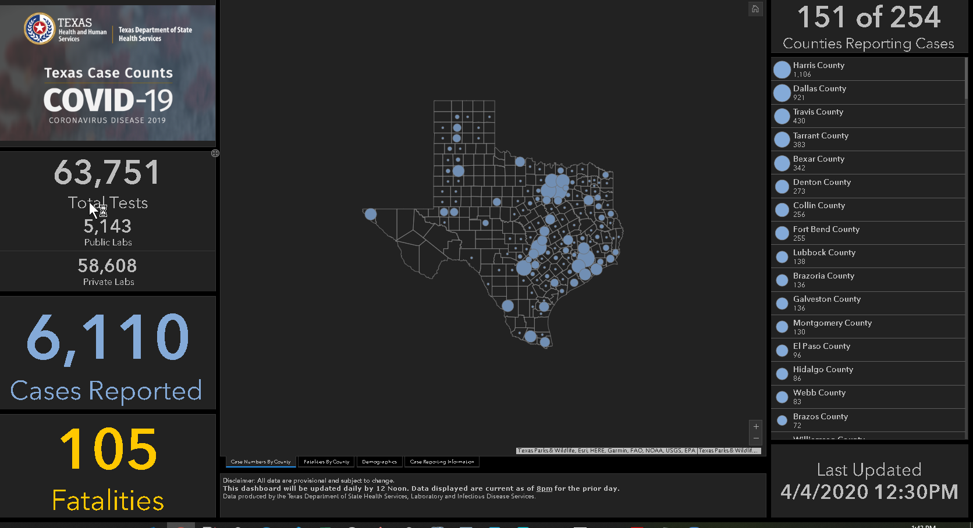
Large Visual Dashboards

Slide 7
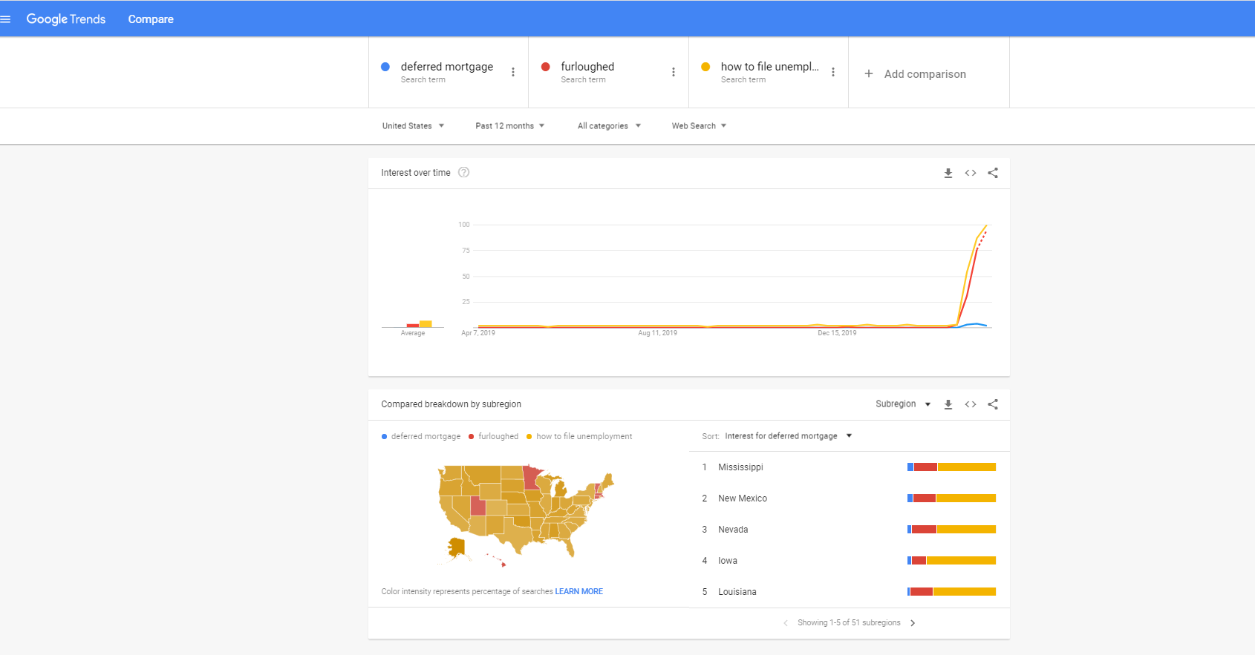
Google Trends
Comparison of search trends:
Deferred Mortgage
Furloughed
‘How to file for unemployment’
https://trends.google.com/trends/explore?geo=US&q=deferred%20mortgage,furloughed,how%20to%20file%20unemployment

Slide 8
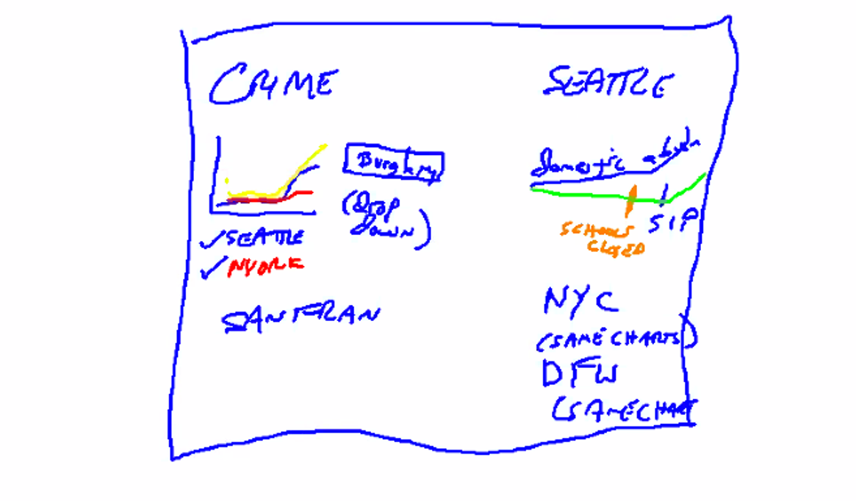
Ideal Visuals (Sketches)
3 visuals showing comparisons on crime s in different cities.

Slide 9
Checklist
Day 1 proposal
Day 2 proposal
Project Requirements
10-min presentation (theme, coding approach, data munging techniques, final visualization)
Visualization including a Python Flask–powered RESTful API, HTML/CSS, JavaScript, and at least one database (SQL, MongoDB, SQLite, etc.).
Group 4 will use the below tracks for Project 2
A custom “creative” D3.js project (i.e., a nonstandard graph or chart)
A dashboard page with multiple charts that update from the same data
JS Library that we did not cover – anime.js
must be powered by a data set with at least 100 records. [DAN SUGESTED A 1000 ROWS]
must include some level of user-driven interaction (e.g., menus, dropdowns, textboxes).
Final visualization should ideally include at least 3 views.

